Slide 1
MUSIC STORE ANALYSIS USING SQL
By Abhishek Bhattacharjee

Slide 2
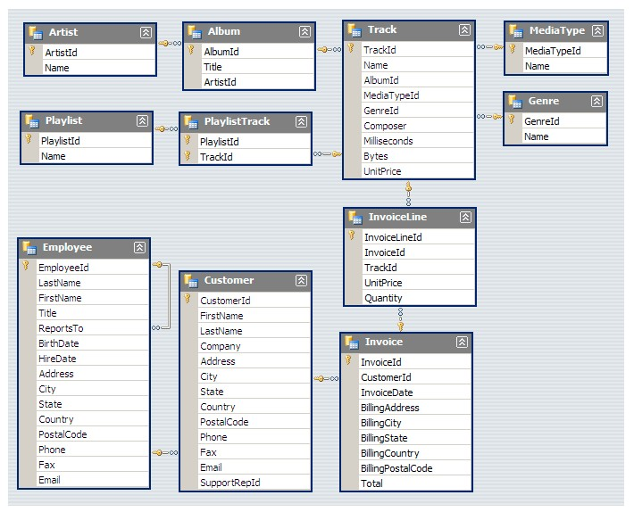
This SQL endeavour delves into the realm of music through an extensive music store dataset. Through the application of SQL queries, the objective of this project is to offer insights into diverse facets of the music industry, encompassing sales analysis, customer behaviour, and genre preferences.
SCHEMA :-

Slide 3
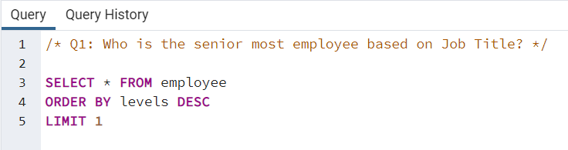
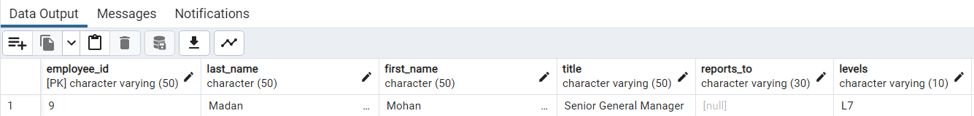

Slide 4
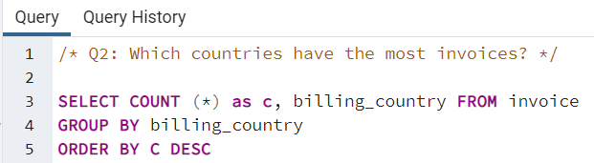
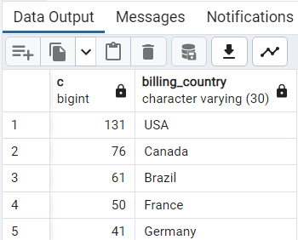

Slide 5
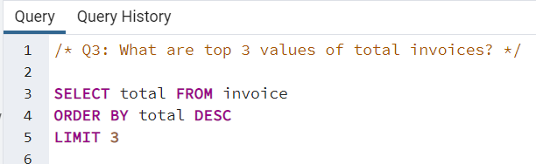
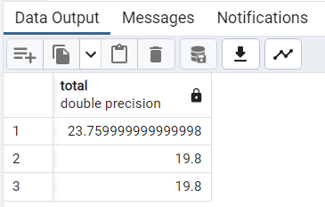

Slide 6
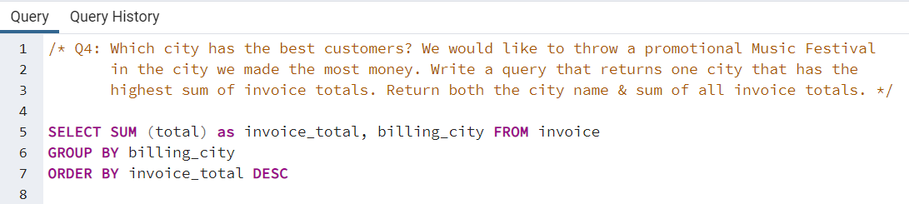
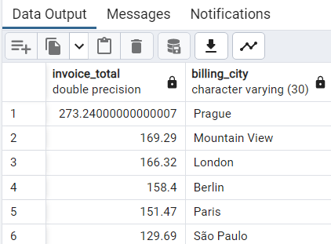

Slide 7
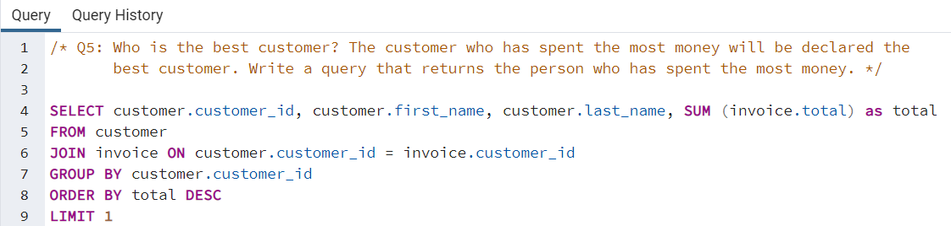
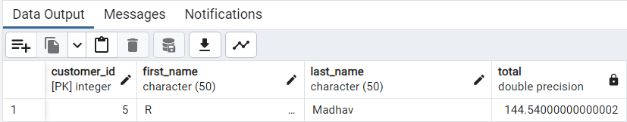

Slide 8
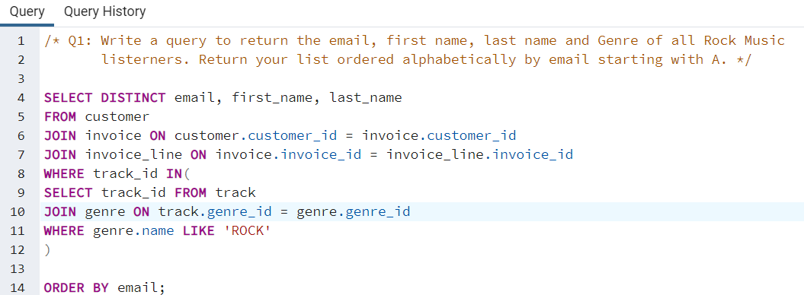
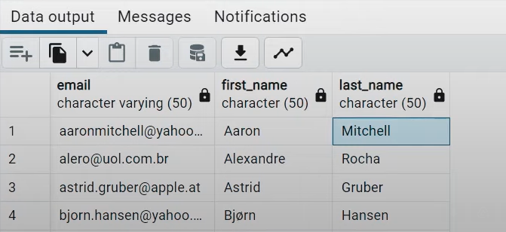

Slide 9
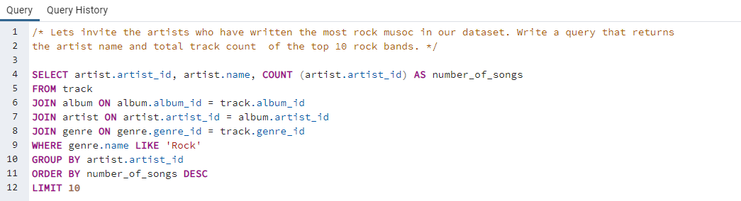
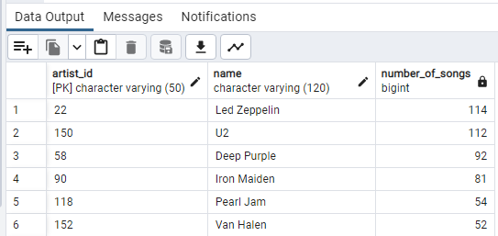

Slide 10
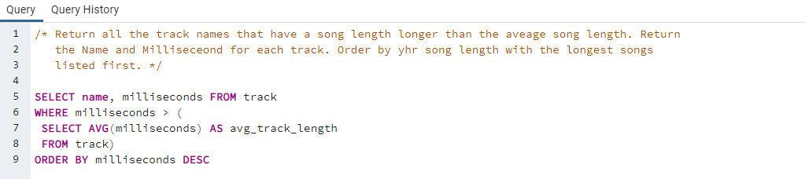
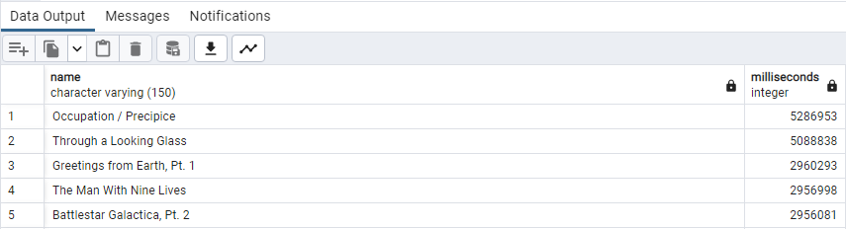

Slide 11
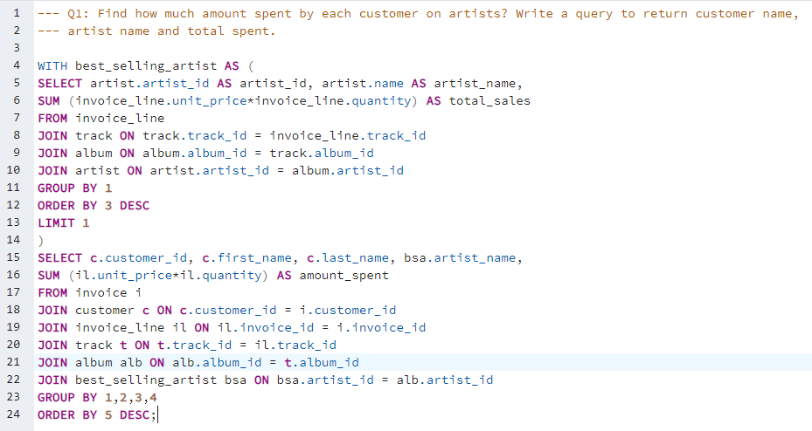
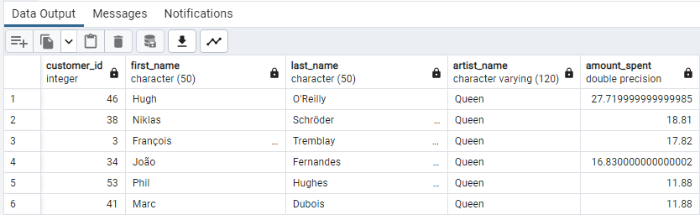

Slide 12
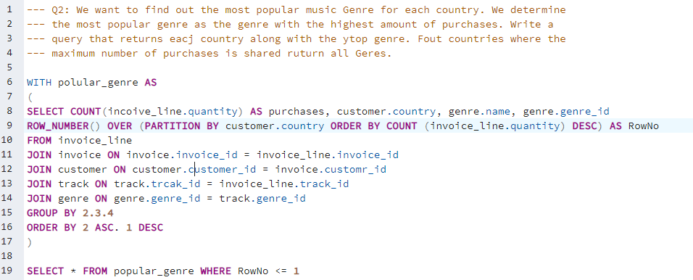
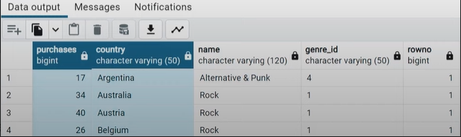

Slide 13
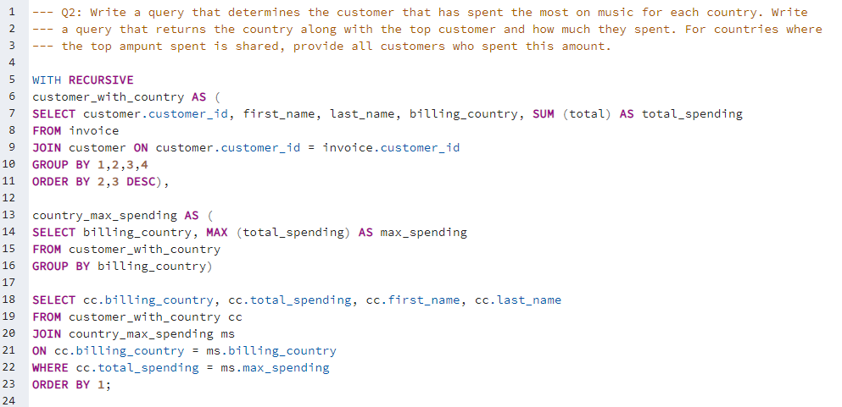
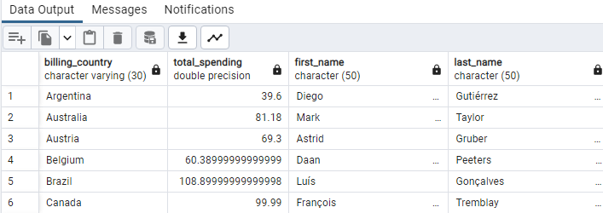

Slide 14
Conclusion :-
The city of Prague distinguishes itself as a notable contributor to the company's revenue, boasting the highest total invoice amount and the top two customers in terms of expenditure hailing from this location.
The analysis reveals that rock music stands out as the most favoured genre across all countries, except for Argentina, where it seems to have lower demand. This observation offers valuable insights for music selection and promotion, implying a strategic emphasis on rock music in marketing campaigns and product offerings.
The predominant portion of customers resides in Europe, constituting roughly 70% of the customer base.
There is a noticeable disparity in the count of employees between senior and junior levels, with a smaller number of individuals holding senior positions

